Slide 1
Course Project Flexible Electronics
Professor: Dr. Aftab M. Hussain
TA: Niteesh Dhayanithi
Saurabh B. Mishra (2023702023), MS-ECE
Ashwin Pramod (2023702007), MS-ECE
Naveen Kr. Gajingam (2023702016), MS-ECE
Shameer (2021802006), PhD-ECE

Slide 2
Project Idea
Aim:
To make flexible touch – based musical Instrument (somewhat like Piano or harmonium)
It can come under “personal fabrication” domain of flexible electronics
Category:
Entertainment and consumer applications
Reason to design:
Affordability
DIY
Easy to fabricate and Easy to use

Slide 3
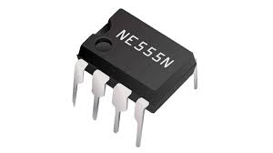
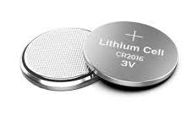
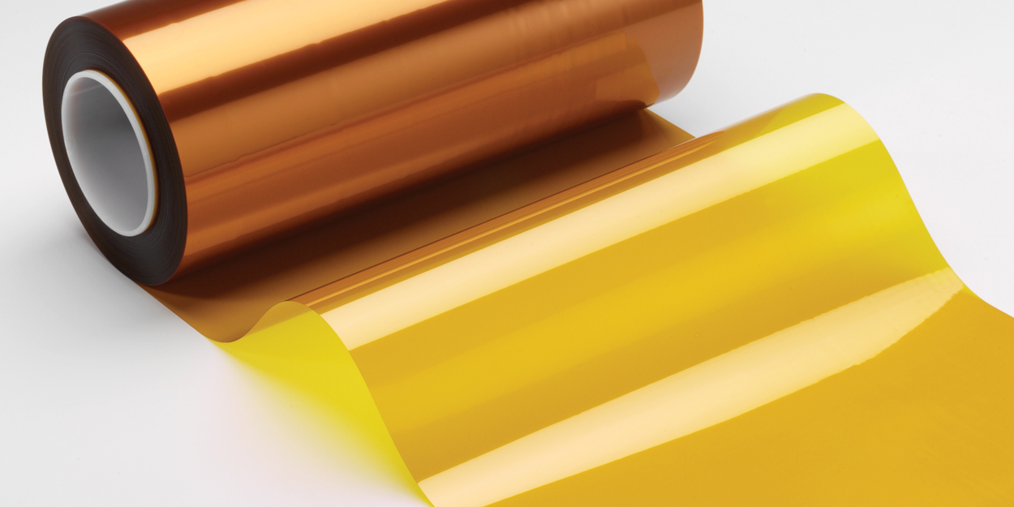
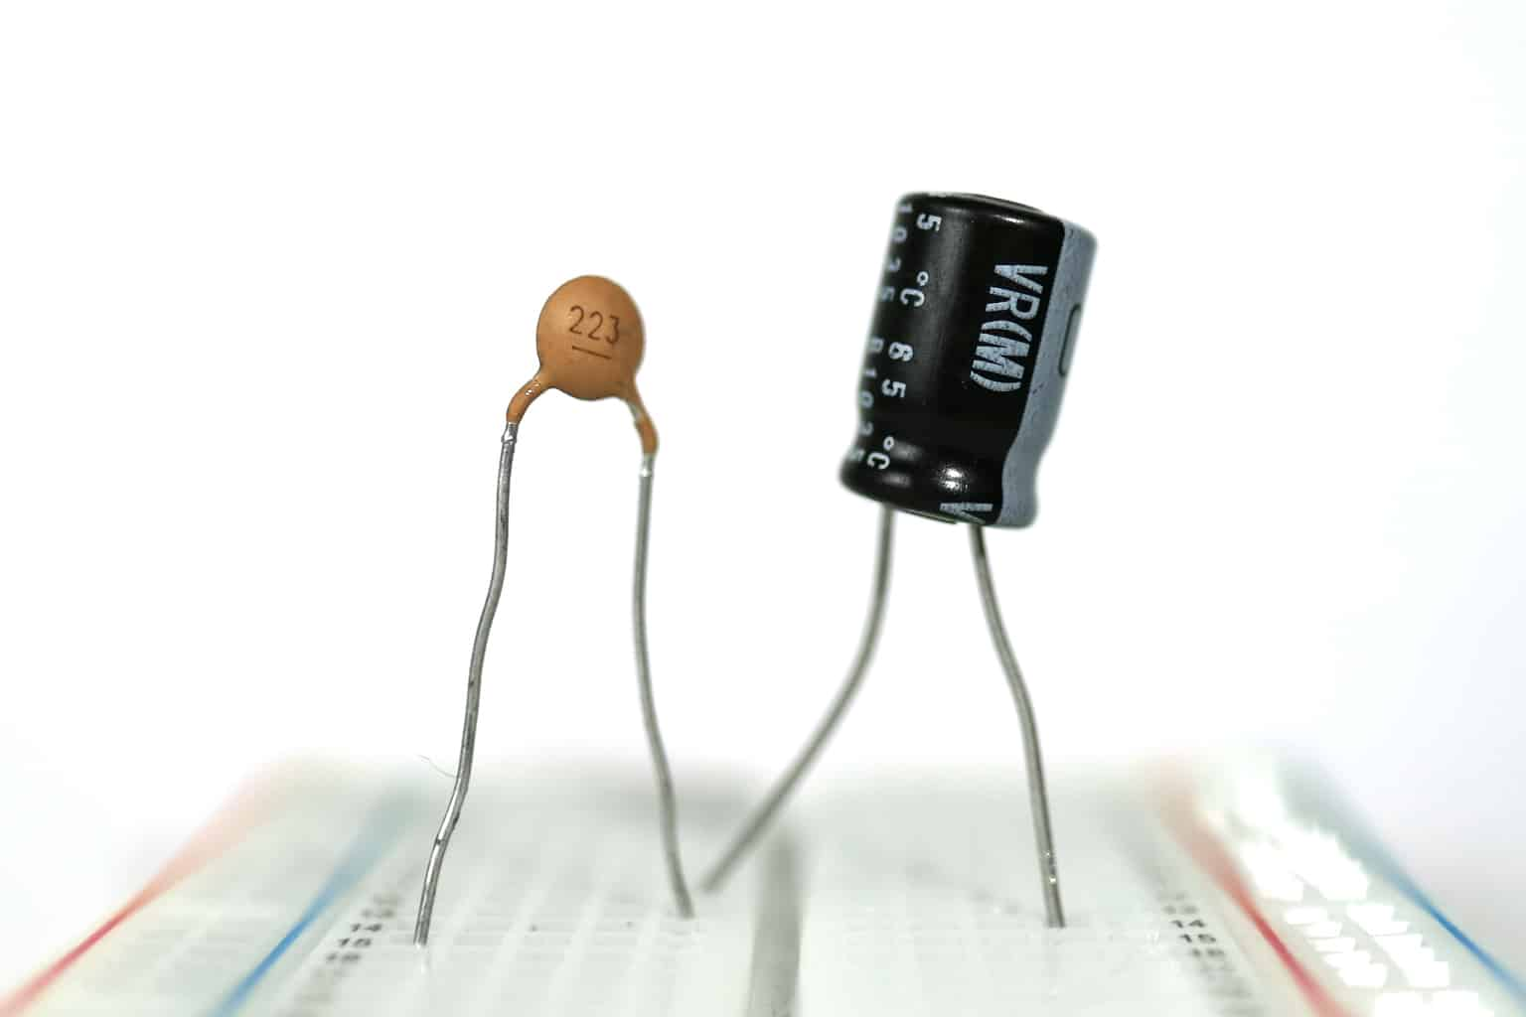
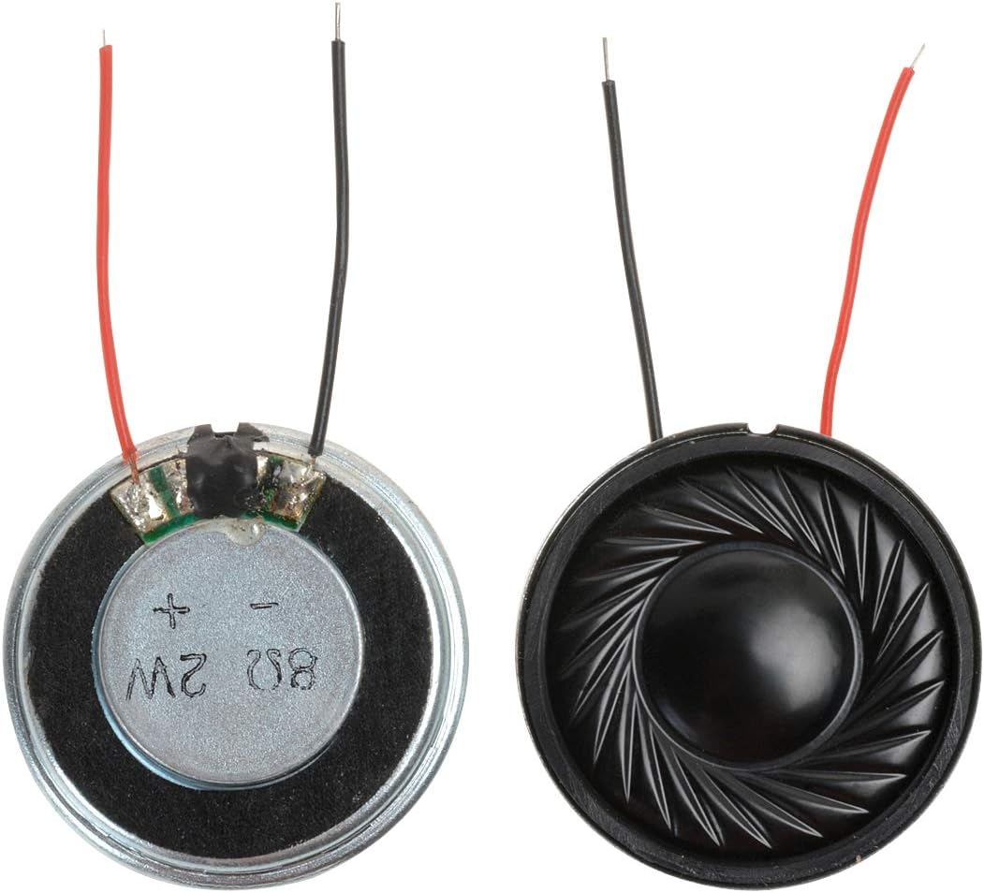
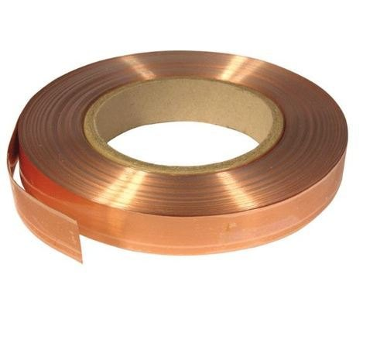
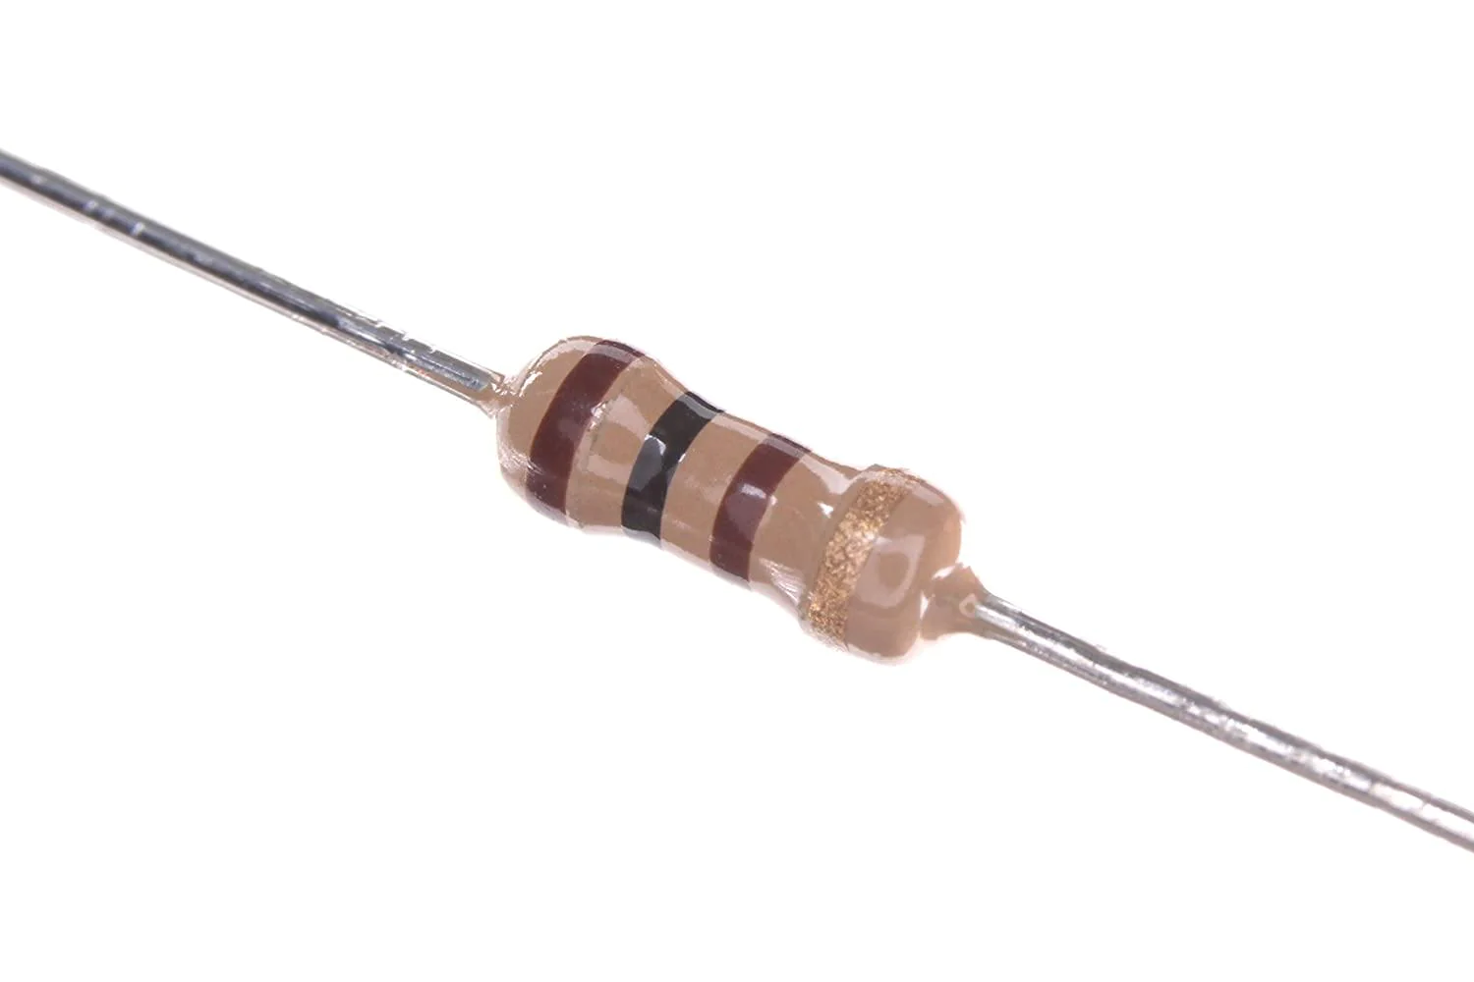
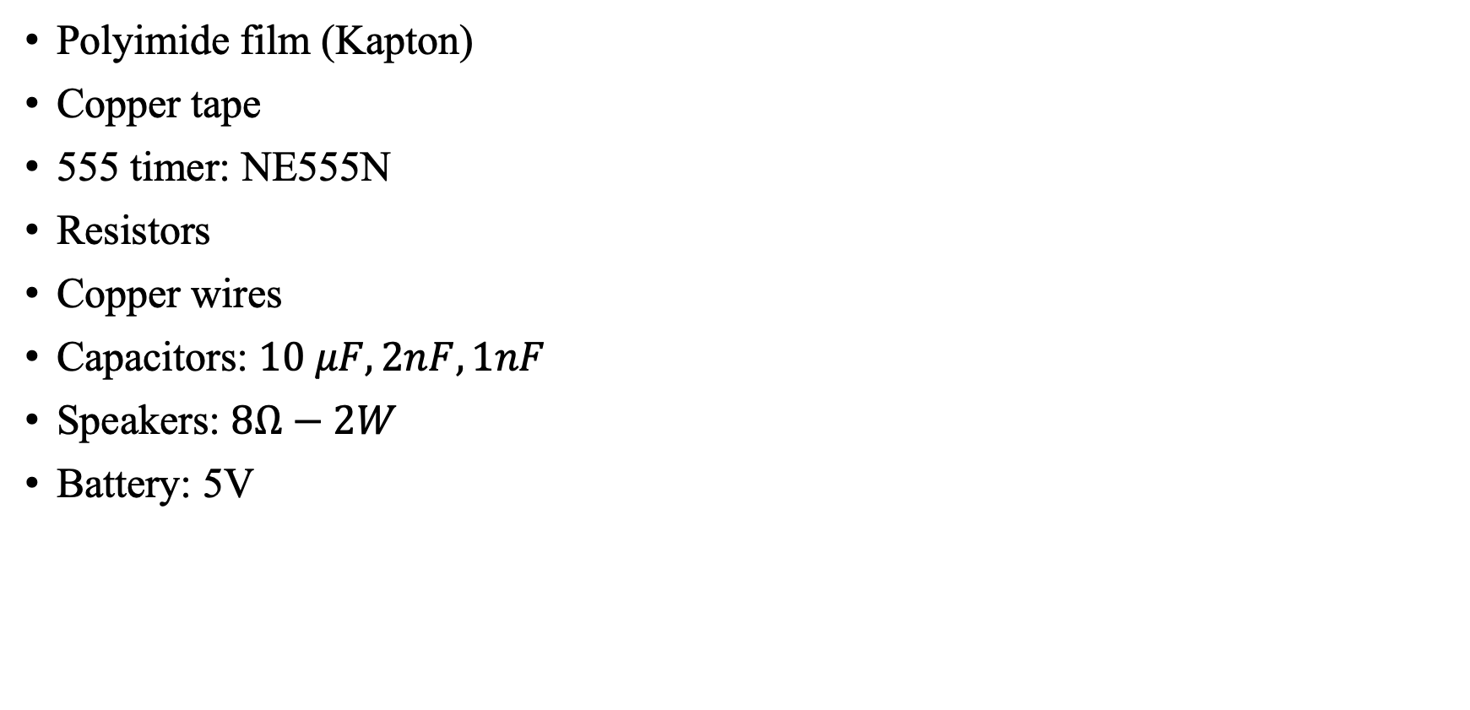
Components used
Polyimide film (Kapton)
Copper tape
555 timer: NE555N
Resistors
Copper wires
Capacitors: $10 μF, 2nF, 1nF$
Speakers: $8Ω−2W$
Battery: 5V

Slide 4
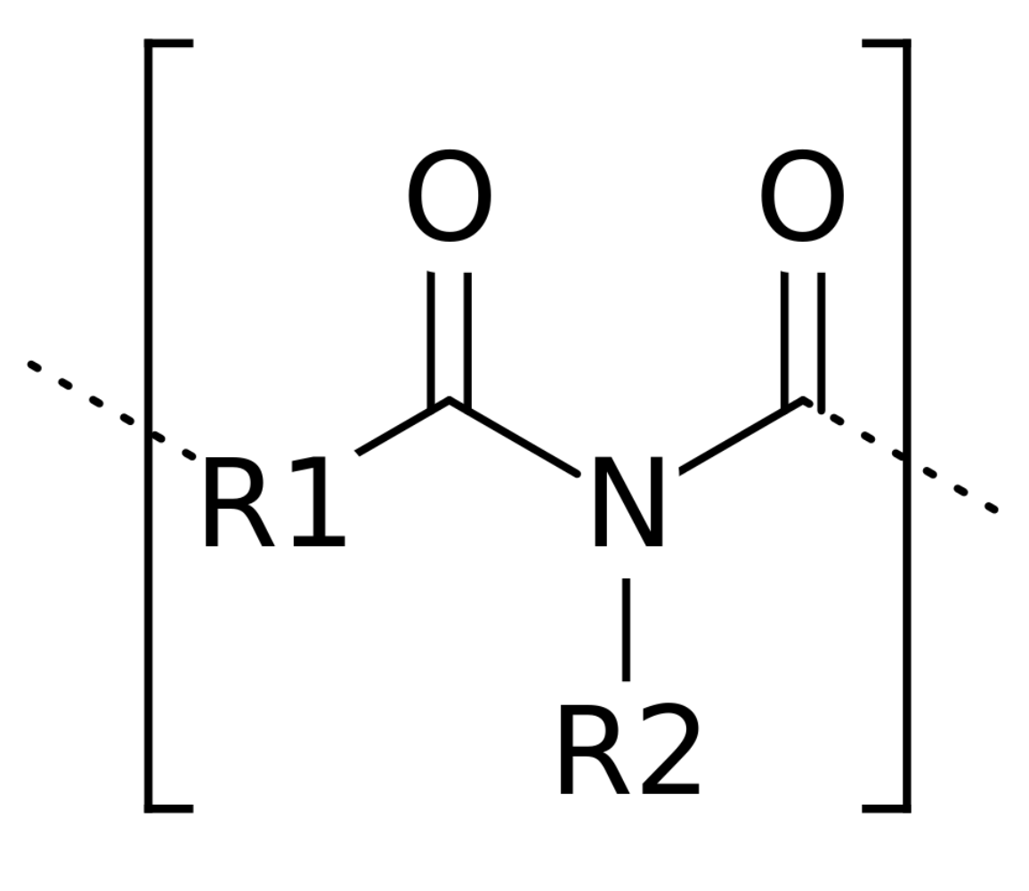
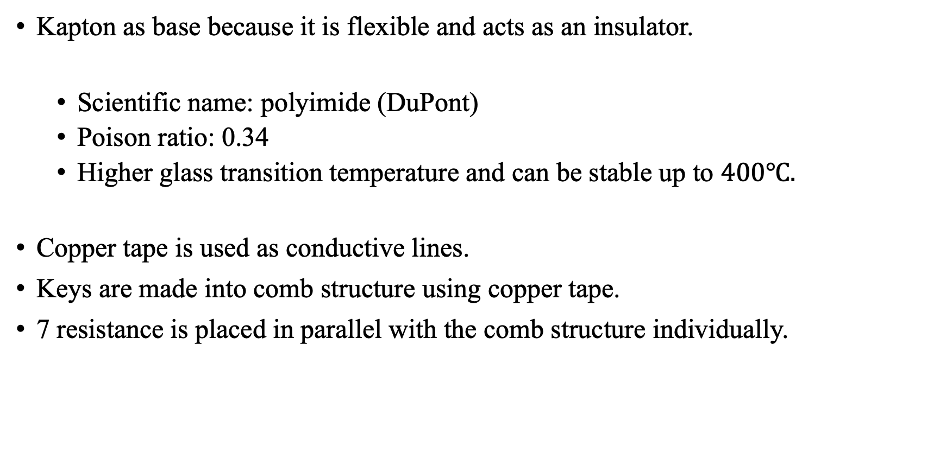
Materials with specifications
Kapton as base because it is flexible and acts as an insulator.
Scientific name: polyimide (DuPont)
Poison ratio: 0.34
Higher glass transition temperature and can be stable up to $400℃.$
Copper tape is used as conductive lines.
Keys are made into comb structure using copper tape.
7 resistance is placed in parallel with the comb structure individually.

Slide 5

Fabrication: Comb structure
Copper tape on Kapton film.
Comb structure
Comb Structure is used to increase the Surface area
Due to this Comb structure even if the finger is not touched completely the tap can be registered
Comb structure with different resisters in parallel provide lesser resistance during touch because our hand have higher resistivity.
Each key (comb structure) when pressed is bit 1, when not pressed is bit 0.
GND
V_{cc}

Slide 6
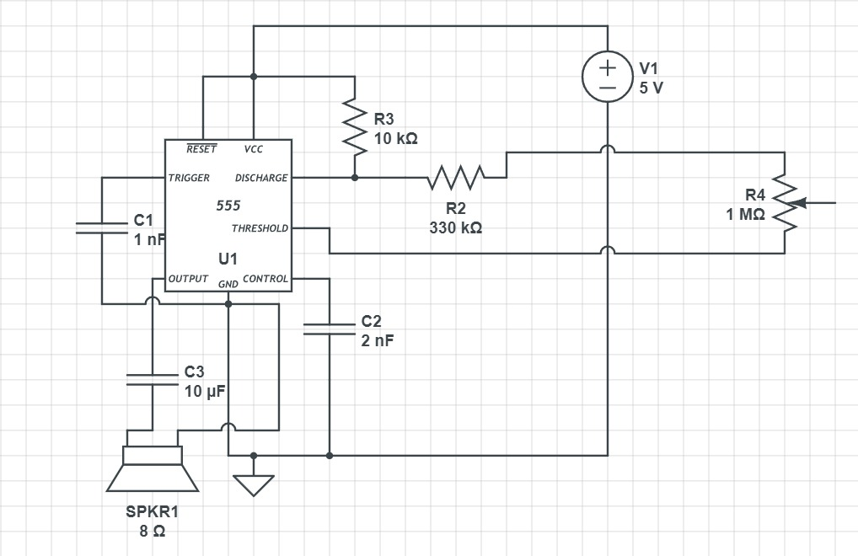
Fabrication: circuit on Kapton
Circuit on Kapton tape
IC’s, speaker, battery, and all other electronics we putted on Kapton substrate with the help of copper tape we solder it.
Voltage provided by two batteries in series.
555 timer circuit is heart of the product
Here, 555 timer circuit is used as free running multivibrator which can produce square wave of different frequencies.
Comb structure

Slide 7
How circuit works
Three fingertips for the operation;
If the Trigger Pin (Pin-2) senses any voltage less than 1/3rd of the supply voltage, it turns ON the output.
If the Threshold Pin (Pin-6) senses any voltage more than 2/3rds of the supply voltage, it turns OFF the output.
Whenever the output of the 555 timer IC is in OFF state, the Discharge Pin (Pin-7) acts as ground/negative rail i.e., it is internally connected to 0V.

Slide 8
How circuit works
Immediately after the power supply is turned on, the capacitor (C1) will be in discharged state and so the voltage at Pin-2 will be 0V.
Since this voltage is less than 1/3rds of the supply voltage, the output turns ON.
Simultaneously Pin-7 will internally disconnect from 0V and so the capacitor starts charging via resistors R1 & R2.
Immediately after the voltage across capacitor (C1) crosses 2/3rds of the supply voltage, Pin-6 senses it and turns OFF the output.
Simultaneously Pin-7 will reconnect internally to 0V, which results in capacitor discharging via resistor R1.
And once the voltage across the capacitor falls below 1/3rd of the supply voltage, Pin-2 will turn ON the output and this whole cycle repeats again and again. (The sequence continues from the 3rd step).

Slide 9
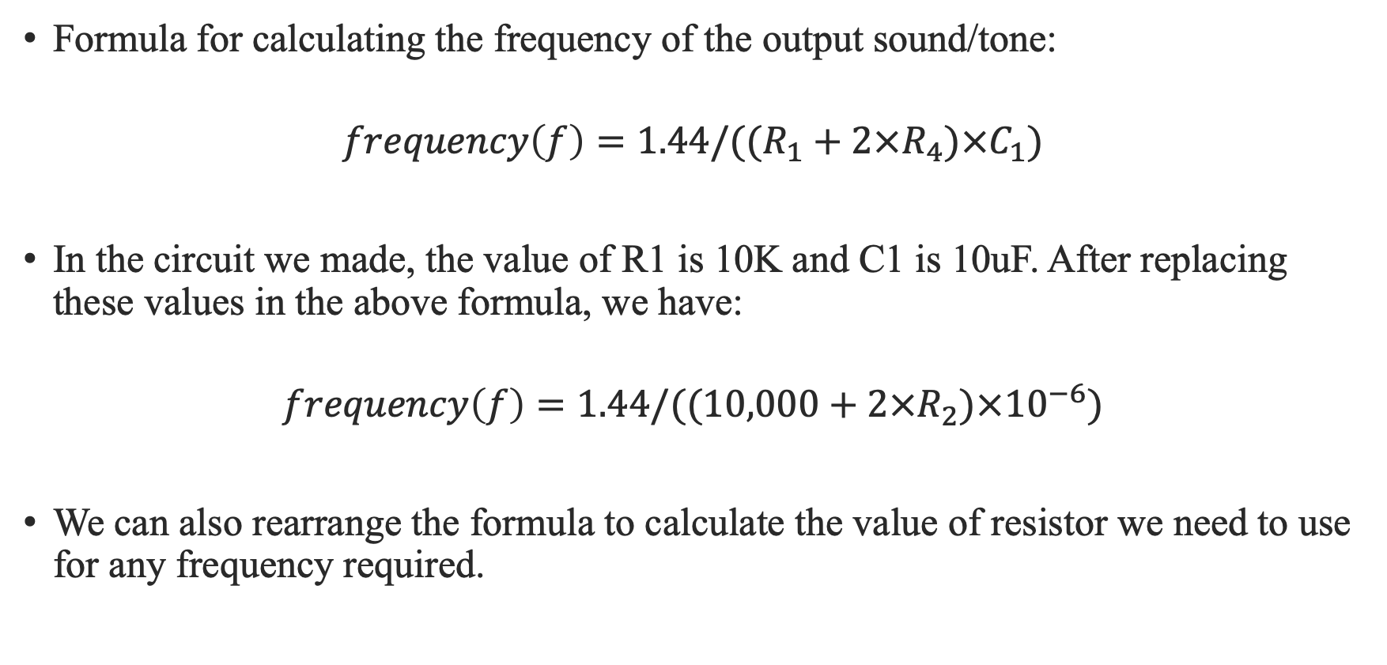
Mathematical Justification
Formula for calculating the frequency of the output sound/tone:
$$frequency\left(f\right)=1.44/((R_{1}+2×R_{4})×C_{1})$$
In the circuit we made, the value of R1 is 10K and C1 is 10uF. After replacing these values in the above formula, we have:
$$frequency\left(f\right)=1.44/((10,000+2×R_{2})×{10}^{−6})$$
We can also rearrange the formula to calculate the value of resistor we need to use for any frequency required.

Slide 10
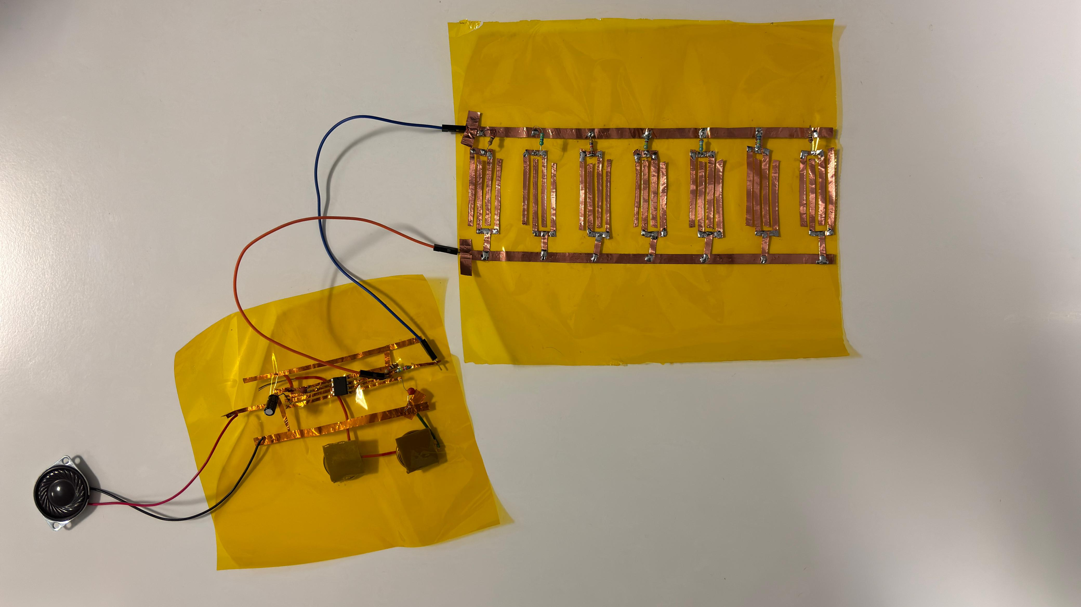
Final Product

Slide 11
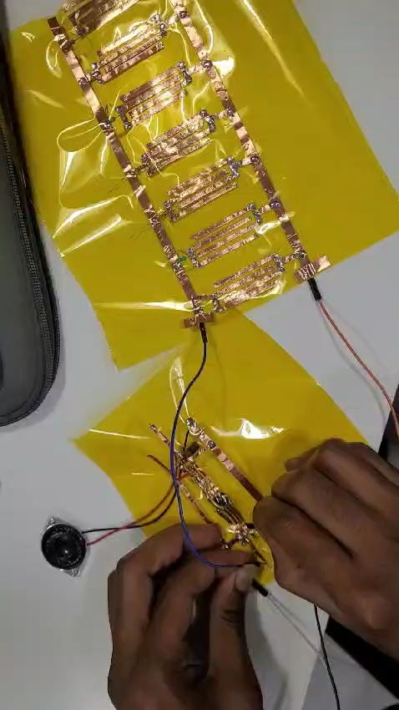
Working Model
Video demonstration

Slide 12
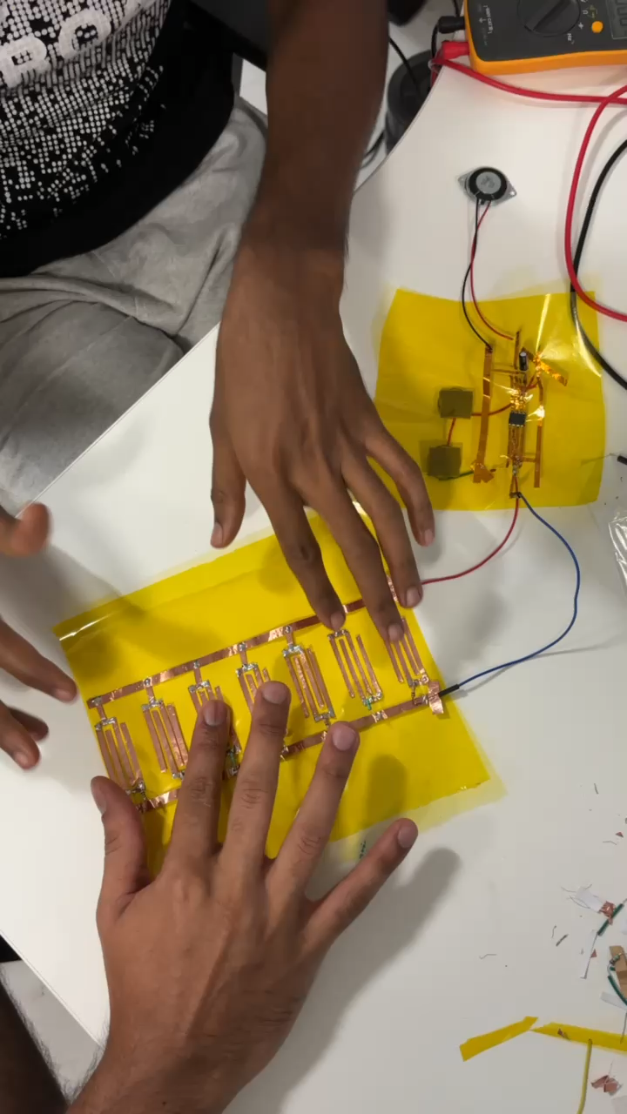
Working Model
Video demonstration

